Slide 1
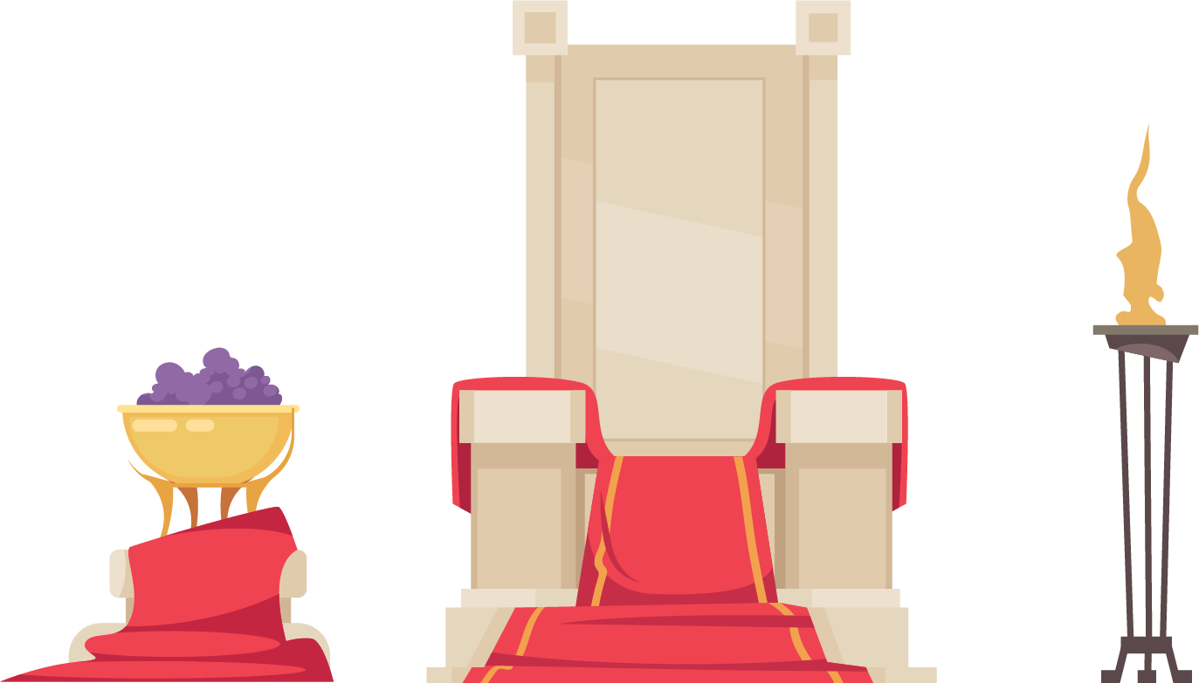
Roman Theatre
Instructor: Faysal Can Dakni
THR 110

Slide 2
Decline of Dramatıc art In rome
Loss of the importance of Gravitas
Power and wealth,
Popularity of non-dramatic entertainments,
Playwrights concerned with profit,
Following the expectation of the Roman audience,
The Rise of Christianity,
New theatrical entertainments: Pantomimus and Mime

Slide 3
Pantomimus
-Pantomime was performed by one single actor,
-Perfomed in Mask,
-Presence of the music,
-Highly choreographed,
-No speech, no verbal communication,
-Famous stories from myths and Greek tragedies,
-Performed in small spaces, a private household,
-More artistic than Mime,
-Required virtuosity,
-Nero performed in his own Pantomimus shows

Slide 4
mıme
No masks,
More than one performer,
Not serious,
Improvised,
Obscene dialogue and lewd speech,
Women were allowed to do Mime acts,
Making fun of people, stories and myths through exaggerating,
Verbal and erotic,
Mostly male audience

Slide 5
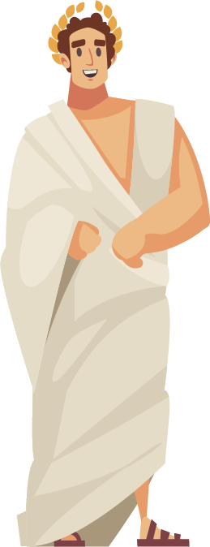
HORATIUS (horace) (65 bc)

Slide 6
Ars poetıca
-The only complete work on theatre theory from Ancient Rome,
-The role of the Playwright as moral instructors of the society,
-Dramatic work should be useful and pleasing,
-It should entertain the audience while educating them,
-Roman Theatre can only be developed by imitating and adapting Greek dramatic works,
-The use of Latin should be encouraged to enrich the language,
-There should be no more than three actors having a speech or text,
-Appearance of a God should be used if only it is necessary,
-The Five- Act Rule: A tragedy should have five acts:
Prologue
Three Epeisodia
Exodos

Slide 7
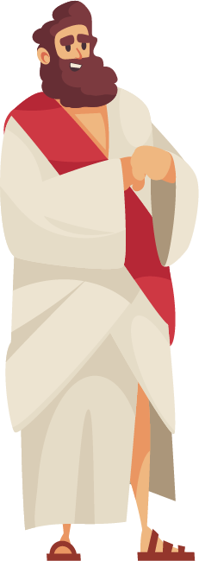
Seneca (4 BCE)
He wrote the 9 surviving plays of Roman Tragedy: “Phaedra”
-Wrote only Closet Dramas (not for public performance),
-Conflict between the passions and reason,
-Onstage violence,
-Embellished Latin language,
-Longer Pathos for the tragic hero,
-Elitist theatre
-Influenced the Elizabethan playwrights.

